Slide 1
Network Security protocol
SSL/TLS
Ipsec
Access Control List
Firewall
Security Attacks
DoS & DDoS
Man-in the middle

Slide 2
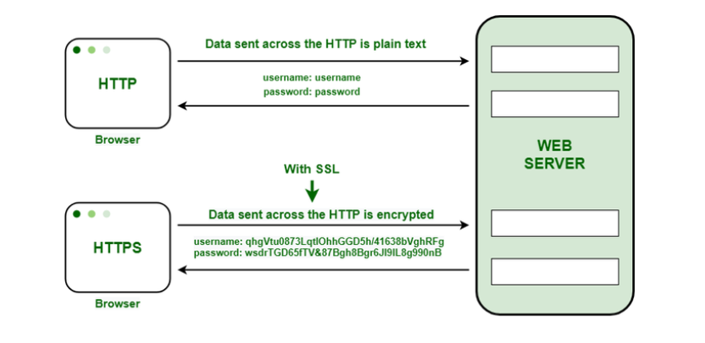
Security protocol
HTTP AND HTTPS
HTTP transmit the data in plaintext
Susceptible to eavesdropping on the internet
HTTPS should be used instead as it encrypt data
HTTPS - Ensures secure communication over the internet by encrypting data, making it crucial for protecting user information. It transforms HTTP data transmission from plaintext to a secure encrypted format.

Slide 3
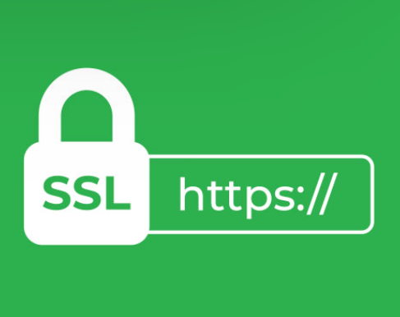
SSL/TLS [Secure socket layer/ Transport layer security]
Acts as the backbone for secure internet communication, with TLS as the updated, more secure version of SSL. These protocols encrypt data transfers, providing confidentiality and integrity between client-server communications.
Protect communication by encrypting it
HTTPS = HTTP + SSL/TLS
SSL is deprecated, TLS is being used
TLS uses port 443 meaning HTTPS uses 443:
Standard HTTP uses port 80
Client connect on port 443, server respond with digital certificate(contain public key of server so both can communicate)
Client /Server also agree on the encryption scheme

Slide 4
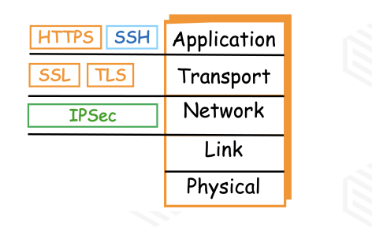
IPSec (IP security)
Operates at the network layer to encrypt and secure IP packets, widely used in VPNs to create secure tunnels over public networks, offering comprehensive security features including authentication, integrity, and confidentiality.
Encrypt at the Network layer
Encrypt regardless of upper layers/protocols
Very popular for creating tunnels
e.g. VPN
Provide confidentiality, integrity and availability (CIA)
IPSec encrypts at the network layer, ideal for secure VPN connections
Application: HTTPS, SSH
Transport: SSL/TLS
Network: IPSec

Slide 5
SSH(Secure SHELL)
SSH allows you to open a “command prompt” or”shell” on a local/remote machine and you can run remote commands.
Uses encryption to create a secure tunnel and uses port 22
Telnet (port 23) – bad idea as it transmit in plaintext

Slide 6
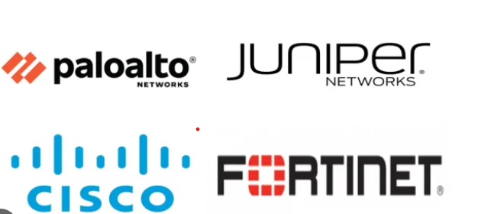
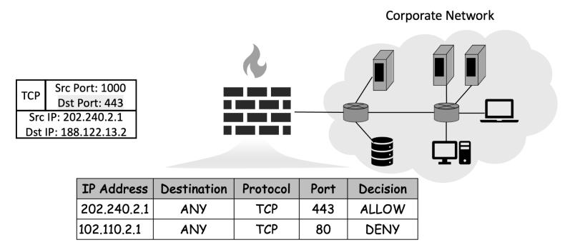
Firewalls
First line of defence against attacks
Composed of: Software, hardware, or both
Rules: Allow or block traffic access
Types: Host-based or network-based
Popular: Palo Alto, Juniper, CICSO
E.g.

Slide 7
FIREWALLS: OPERATIONS
Host-based vs. Network-based
Host-based: Protects individual devices, often software-based
Network-based: Secures an entire network, typically hardware-based
List of firewall rules is called Access Control list
Rules can allow/block traffic based on:
Source IP Address (block known malicious IP addresses)
Destination IP Address (block access to DBs or sensitive PCs)
Source Port
Destination Port (Block vulnerable ports e.g. 80/HTTP,23/Telnet )
Protocol (Block vulnerable protocol e.g. ICMP/Ping)

Slide 8
ACL (Access Control List)
An access control list(ACL) is a list of rules that specifies which users or system are granted or denied access to particular object or system resource. Access control list are also installed in router or switch's where they act as filters, managing which traffic can access the network.
Example:
https://medium.com/@sanjaypn18/network-access-control-list-91376f4fdc27
Standard | Extended
Filter based on source | Filter based on source and destination
Permit or deny entire TCP/IP protocol suite | Specifies a specific IP protocol and port number
Range is 1-99 and 1300-1999 | Range is 100-199 and 2000-2699

Slide 9
NEXT-GENERATION FIREWALLS
Operate at the Application layer, are also knows as:
Deep Packet Inspection Firewalls
Application-Level Gateway Firewalls
Inspect applications instead of just network headers e.g. can detect if it is traffic from
torrent, YouTube, skype
Since app is known, so more specific malware to attack signature can be used, enhancing its power
Can intelligently detect patterns/payload and block
Can allows or block specific application
Can block parts of application e.g.
Disallow file download on skype
Allow file uploads on skype

Slide 10
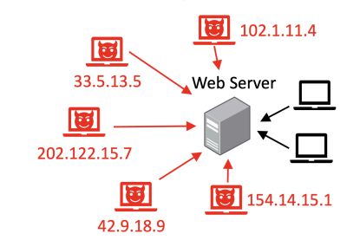
Security Attacks
DOS (DENIAL OF SERVICE)
Any attacks which causes service to be slow or unavailable to legitimate users is termed as Dos attack
Example:
Crashing a web server or database server
Overloading web/database servers through bogus requests
Choking the network through bogus traffic
DoS →Attack from one IP address/source (easy to block)
DDoS → Attack from multiple IP addresses

Slide 11
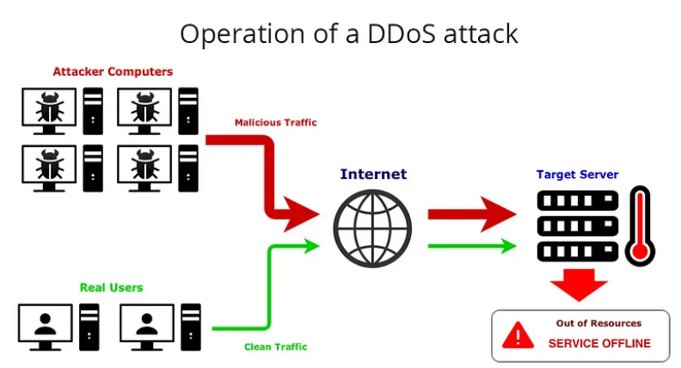
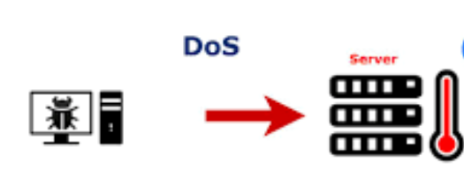
DDOS (DISTRIBUTED DENIAL OF SERVICE)
DoS: Send a flood of packets (Ping, TCP requests)
Easy to detect and block the single IP address
Distributed DoS Attack : Multiple Ips, difficult to block

Slide 12
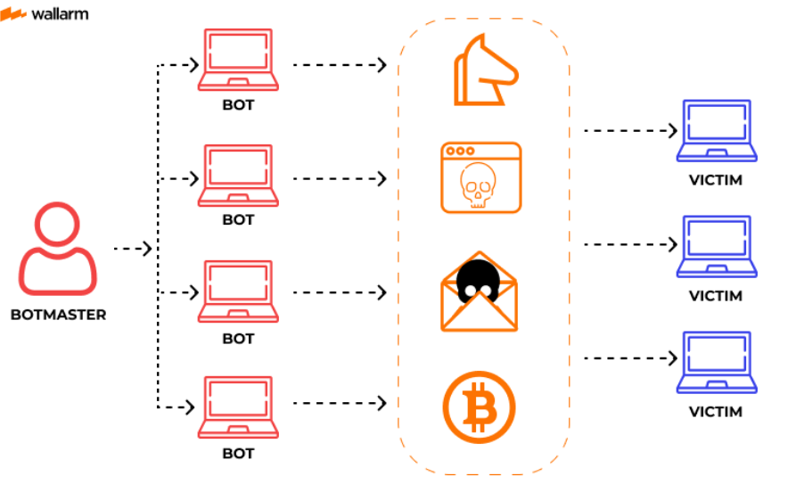
BOTS AND BOTNETS
Malicious software is installed on PCs and servers
These systems becomes “Bots”, network of Bots ->Botnet
Attacker does not attack directly -> army of bots attacks

Slide 13
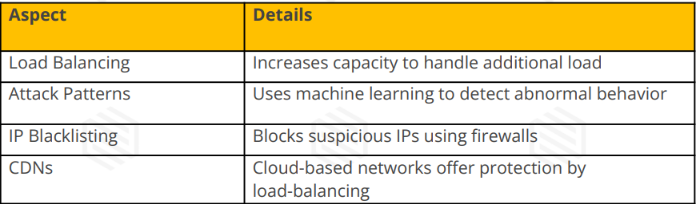
THREATS POSED BY BOTS/BOTNETS
Loss of service to legitimate clients
Loss of service to employee
Financial loss (Kaspersky research - $1.6 million)
Reputational damage
DDoS PREVENTATION TECHNIQUES

Slide 14
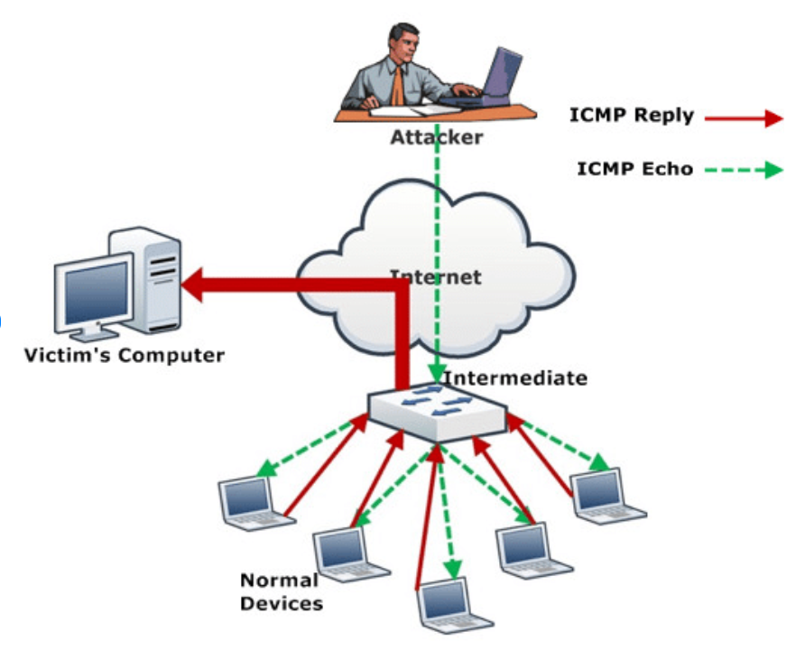
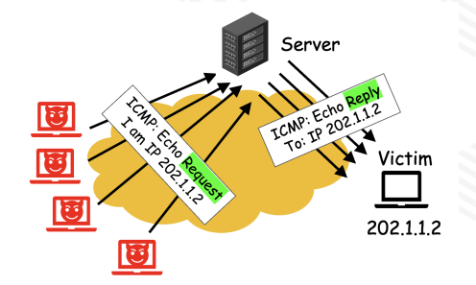
Network Attacks SMURF ATTACK
Flood of ICMP ping requests sent with victim’s spoofed IP address
Server respond with a flood of ICMP response messages.
Can crash the victim machine
Difficult to detect the original attacker due to reflection
A number of router/domain on the internet block ICMP traffic.
Internal network Anomaly detection for blocking Smurf attacks

Slide 15
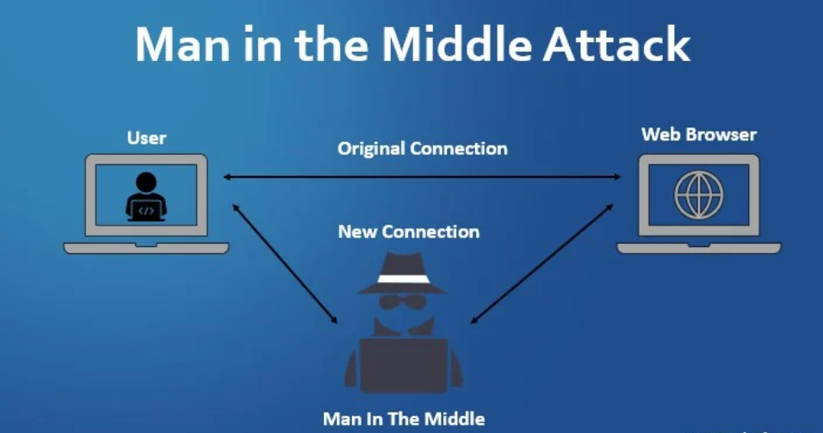
MAN IN THE MIDDLE ATTACK
A large class of attacks with lots of possibilities
Replay traffic and just copy sensitive information:
Browser session information
Password
Credit card information
Replay traffic after modifying traffic
IP spoofing
Masquerading as someone else using their IP address
DNS spoofing
Trick user into visiting malicious website thinking they are legitimate
SSL hijacking
When visiting unsecure website(80) the server redirects you to a secure version (SSL/TLS-443) but this step gets compromised.
Email hijacking
A malicious user gains access to email account, monitor it and sends a crafted email.

Slide 16
PREVENTING MITM
Strong Encryption on Wireless Access Points
Use VPNs for remote access for secure encrypted communication
Force HTTPS to avoid eavesdropping
Authentication using public key Pair too ensure authenticity

Slide 17
DevSecOps Tools
OWASP ZAP (Zed Attack Proxy)
Official website: https://www.zaproxy.org/
Documentation: https://www.zaproxy.org/docs/
GitHub Repository: https://github.com/zaproxy/zaproxy
SonarQube (Code Quality and Security)
Official website: https://www.sonarqube.org/
Documentation: https://docs.sonarqube.org/latest/
HashiCorp Vault (Secrets Management)
Official website: https://www.vaultproject.io/
Documentation: https://www.vaultproject.io/docs
Trivy (Vulnerability Scanner)
Official GitHub Repository: https://github.com/aquasecurity/trivy
Documentation: https://aquasecurity.github.io/trivy/
Snyk (Developer Security)
Official website: https://snyk.io/
Documentation: https://docs.snyk.io/

Slide 18
